Slide 1

iCare Bot
Symptom Checker
Gen Ai Project Presentation

Slide 2
Presentation Outline
Business Problem
Rationale For Genai
Prior Research & Solutions
Our Genai-based Prototype
Prototype Demo
Conclusion

Slide 3

Project Team
Beeb Ajibola
Kehinde Oduwaye
Lordina Osei
Tochukwu Nto Mbah
Charles Wibonele

Slide 4

Business Problem

Slide 5

The problem and why Gen AI is the answer
Elvina Mould Case
While vacationing in Mauritius, Elvina Mould — daughter of a Ghanaian politician — fell ill and was misdiagnosed despite multiple hospital visits. The real cause, severe malaria, was discovered too late, and she tragically passed away. Her story shows the deadly cost of delayed diagnosis.
📊 Statistics
- 1 in 20 harmed yearly by misdiagnosis - 40k–80k deaths from diagnostic errors - 62% of doctors report burnout - 30–50% ER visits are non-urgent - 78% expect faster digital triage
Elvina Mould’s Case
Problem Summary
- Overloaded emergency departments - Delayed access to the right specialist - Inaccurate self-diagnosis by patients - Underuse of telehealth for remote care
💡 Why GenAI
GenAI can understand free-text symptoms, retrieve relevant conditions, and flag urgent cases early. It helps hospitals provide faster, smarter, and safer care from the first interaction.

Slide 6
Existing Solutions
Babylon Health (2020–2023)
What it did:
Used AI chatbot + symptom database to allow users to describe symptoms naturally.
How it worked:
Combined natural language understanding (NLP) with a structured knowledge base of diseases (very similar to RAG + LLM combo).
Problem:
Limited flexibility; struggled with nuanced, multiple-symptom cases.
Relevance to you:
You are improving this approach by grounding answers better with retrieval and GenAI.
Ada Health
(2016–Present)
What it does: An AI symptom checker app where users answer a chat-based medical questionnaire.
How it works: Decision trees + Bayesian models + medical knowledge base.
Problem: Relies heavily on structured input ("yes/no" questions) — not free text natural language.
Relevance to you: You are advancing beyond Ada by allowing natural language input processed by an LLM.
Buoy Health
(2018–2023)
What it does: AI chatbot for self-diagnosis and healthcare navigation.
How it works: A hybrid of machine learning and medical knowledge graphs to recommend next steps (not diagnoses).
Problem: Limited in complex cases or vague symptoms.
Relevance to you: Like your system, Buoy uses AI for triage — but your model is likely smarter with GenAI natural responses and retrieval grounding.

Slide 7
Our Solution

Slide 8
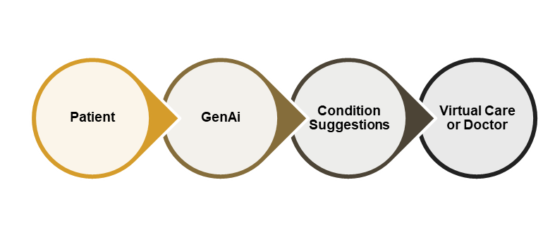

GenAI Symptom Checker
AI-driven tool to interpret patient symptom descriptions in natural language. Matches symptoms to possible conditions based on trained medical knowledge base.
Generates preliminary diagnostic suggestions while keeping human in the loop(non-final).
Routes complex cases to human healthcare professionals.
Rationale:
GenAI-powered symptom checkers offer a life-saving bridge between patient needs and faster, smarter care

Slide 9
Our GenAI Solution
Symptom Checker —matching symptoms to a condition
Urgency Prediction — Predicting the urgency of medical needs
Flexible Multi-Symptom Matching — handles multiple symptoms at once
User-Friendly Interaction — clear, empathetic conversation flow
Edge Case Escalation — Recommending the appropriate care level
Key Features of Our Symptom Checker

Slide 10
How it Works

Slide 11

Functionality
RAG Pipeline
Symptom-to-Condition Matching
Combines retrieved data with GenAI (GPT) to produce grounded answers.
Searches the FAISS database for the most relevant medical records.
NLP Processing
Condition Suggestion
Analyzes user symptom input.
Generates a list of possible conditions based on matching.
Urgency Classification
Scalability
Classifies symptoms as urgent or non-urgent.
Many patients can use it at once.

Slide 12


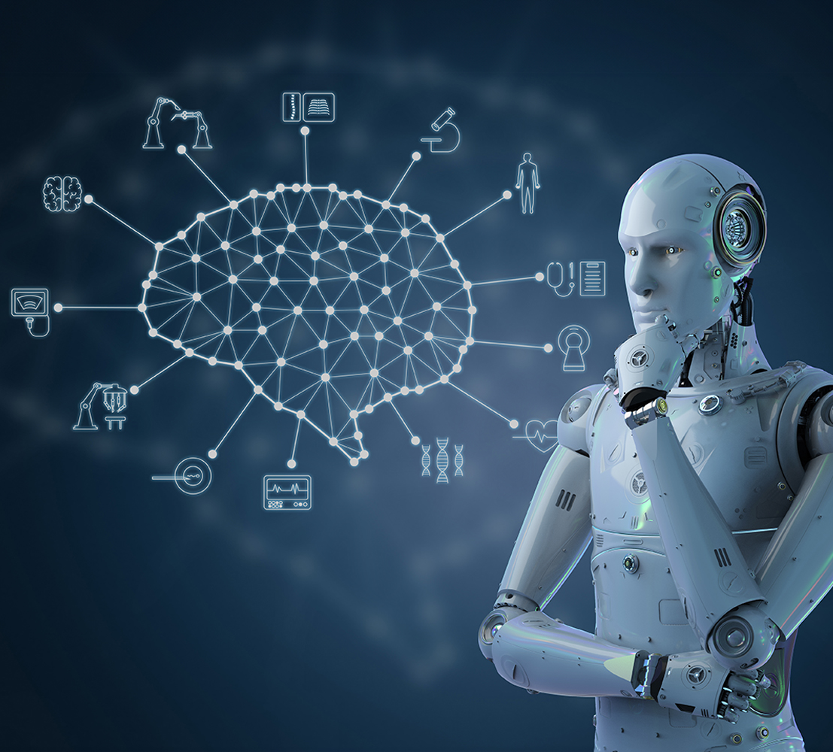

Matches Input
Go to hospital
GenAI Model processes
Sends Condition back to patient.
Urgent
User inputs symptoms in natural language
Outputs lists probable conditions
Not Urgent
Get virtual care
Start
How our Gen AI Works

Slide 13

Keeping Humans in the Loop…
Escalation for Urgent or Critical Symptoms
Automatically flag high-risk inputs for immediate clinician review
Low Confidence Predictions
If the AI shows uncertainty, prompt: “This may require medical review.” Allow human verification before acting.
On-Demand Human Support
If users request help (e.g. “Can I speak to someone?”),route to nurse hotline, live chat, or appointment scheduler.
Post-Triage Human Verification
In high-risk cases, a nurse or staff member verifies AI’s triage suggestion before action is taken.
Continuous Human Auditing
Medical experts periodically review past AI responses to improve model accuracy and maintain safety.
User Feedback Triggers Review
After each session, allow: “Was this helpful?” → If “No,” flag for manual case follow-up.

Slide 14
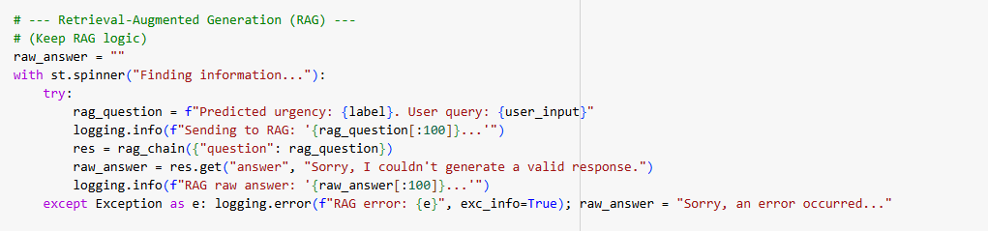
RAG Pipeline
Uses LangChain's ConversationalRetrievalChain.
Employs ChatOpenAI (gpt-3.5-turbo) as the LLM.
Uses OpenAIEmbeddings (text-embedding-3-small) for vectorization.
Retrieves context from Pinecone via PineconeVectorStore and a custom ScrubbingRetriever.

Slide 15
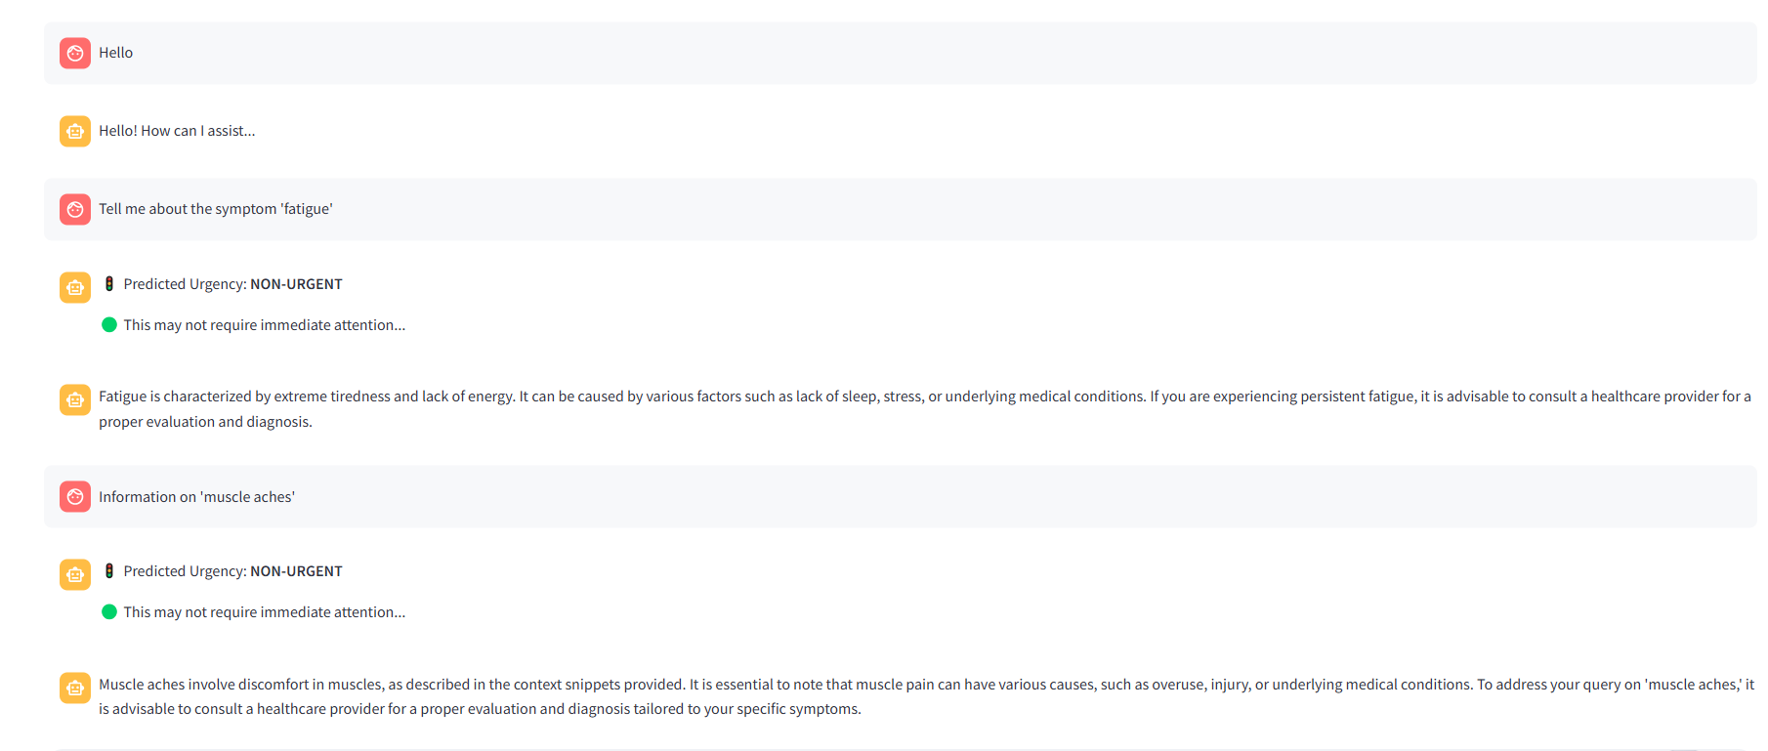
Prototype Demo

Slide 16
Insights

Slide 17
Key findings from Our GenAI Use-Case
Diagnostic Accuracy
User
Satisfaction
Precision
and Safety
Model
Strength
The prototype achieved:
75–80% triage accuracy.
Caught 100% of critical emergency cases, showing high sensitivity.
Diagnostic suggestions were often correct or pointed.
Feedback from the prototype test was very positive.
Users find the assistant easy to use and its guidance clear.
Satisfaction would likely be high because of assistant’s human-friendly explanations.
Model showed:
High precision by rarely misclassifying and leaned toward caution when it erred.
No unsafe recommendations, making it safer.
Model showed:
Strong natural language understanding.
Gave clear and detailed explanations.
Connected symptoms to possible conditions.
Asked smart follow-up questions.

Slide 18
Limitations
Possible Errors and Hallucinations
Despite prompt instructions, LLMs can still hallucinate facts or details not present in the provided context. The current prompt aims to minimize this but doesn't eliminate it entirely.
Security & Maintenance:
Failure to reliably redact PII, especially if the bot were handling more sensitive inputs or if logs were stored long-term, is a major limitation in a healthcare context.
It Requires ongoing effort to update the knowledge base, retrainin the urgency model, and potentially updating the PII regex/libraries and prompts as new issues arise or vulnerabilities are discovered
LLM Ability:
The LLM processes language patterns; it doesn't possess genuine clinical reasoning or diagnostic capability. Its advice is purely informational based on its training and the provided context.

Slide 19
Recommendations
Adopt Human-in-the-loop AI
Ensure Clinicians verify high-risk or uncertain cases flagged by the bot
Enforce HIPAA & PII Standards:
Secure data logging, anonymize inputs, and conduct regular compliance audits.
Continuously Update Medical Knowledge
Refresh vector database with the latest medical literature and symptom patterns

Slide 20
Conclusion

Slide 21

Conclusion
In today’s world, delays or mistakes in diagnosis can cost lives. That’s why early symptom checking isn’t just helpful — it’s essential
Our GenAI Symptom Checker gives patients quick, clear support from the moment they feel unwell. It helps guide them toward the right care, faster and more safely.
By using AI and real medical knowledge together, we’re making healthcare more accurate, more accessible, and more human-centered.

Slide 22

Insights and Conclusion

